Slide 1
Big Mountain Resort
Data Science Presentation

Slide 2
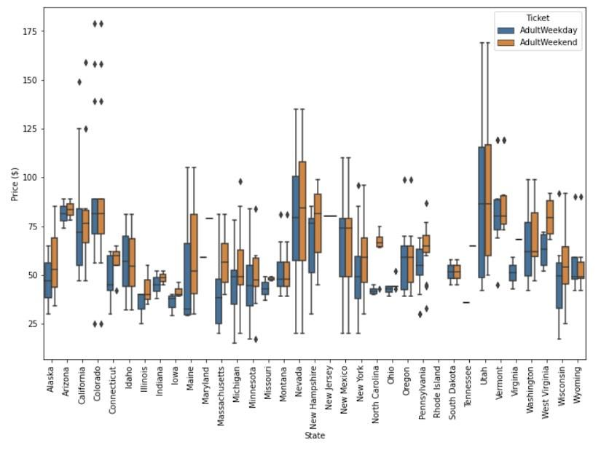
Price Comparison
There's a suspicion that Big Mountain is not capitalizing on its facilities as much as it could.
Most prices appear to lie in a broad band from around 25 to over 100 dollars.

Slide 3
18% increase
Big Mountain Resort modelled price is $95.87, actual price is $81.00.
Even with the expected mean absolute error of $10.39, this suggests there is room for an increase.

Slide 4
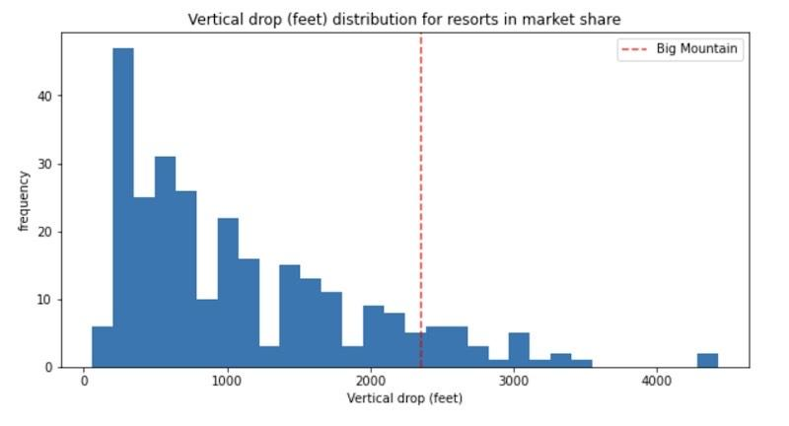
Features of interest
Big Mountain is doing well for vertical drop, but there are still quite a few resorts with a greater drop.

Slide 5
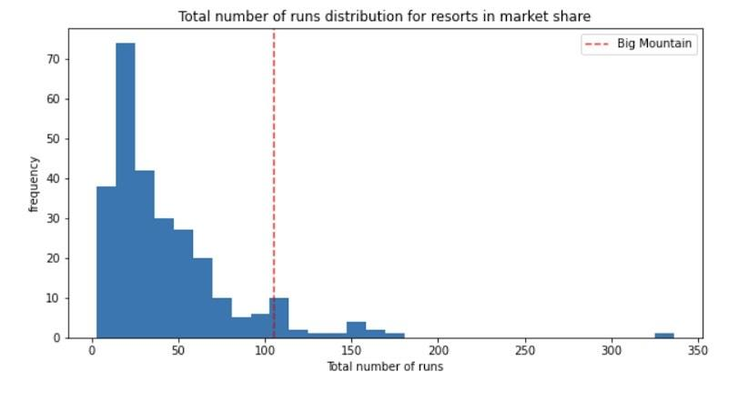
Features of interest
Big Mountain compares well for the number of runs. There are some resorts with more, but not many.

Slide 6
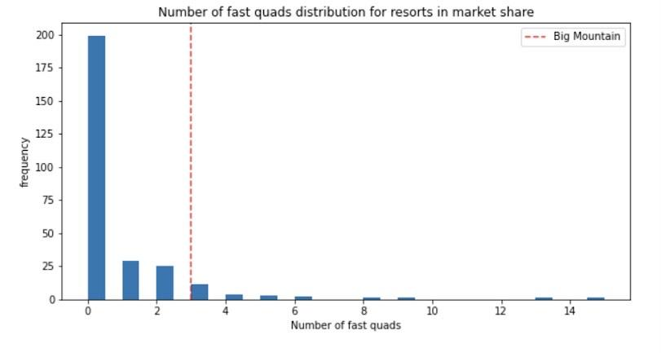
Features of interest
Most resorts have no fast quads. Big Mountain has 3, which puts it high up that league table. There are some values much higher, but they are rare.

Slide 7
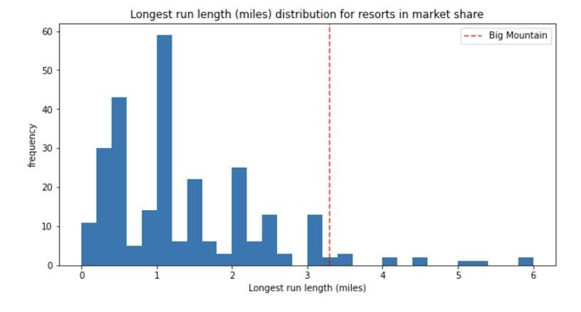
Features of interest
Big Mountain has one of the longest runs. Although it is just over half the length of the longest, the longer ones are rare.

Slide 8
Big Mountain Resort is undervalued.
Though there is a need to cut costs, there are many features that encourage the decision to raise the ticket price.

